Slide 1
mining Internet of Things Data
Beiyu Lin

Slide 2
Data Properties of smart environment
Notes:
Ubiquitous (u – bit – quick – tis)
Actuator (act – true- ate – or)

Slide 3
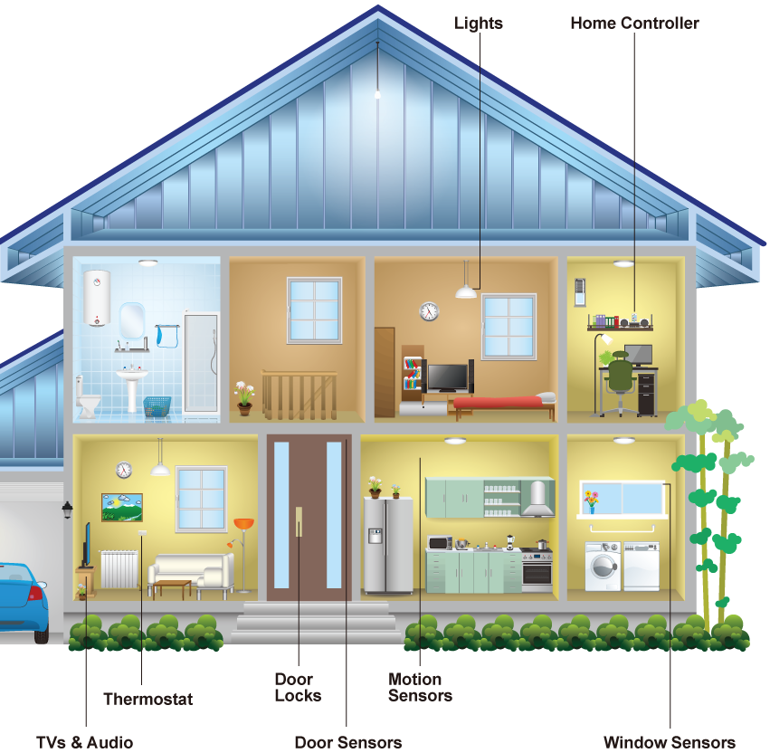
Sensor Data
Sensor types: infrared motion(narrow/wide-area), ambient light, magnetic, and temperature sensors.
2011-06-13 | 21:48:43 | Bathroom | ON | Personal_Hygiene
2011-06-13 | 21:48:44 | Bathroom | OFF | Personal_Hygiene
2011-06-13 | 22:47:02 | Bedroom | ON | Personal_Hygiene
2011-06-13 | 22:47:04 | Bedroom | OFF | Sleep
2011-06-13 | 22:47:06 | Bedroom | ON | Sleep
………………
2011-06-14 | 10:11:24 | Kitchen | ON | Wash_Dishes
2011-06-14 | 10:11:25 | Kitchen | OFF | Wash_Dishes
2011-06-14 | 10:11:40 | Kitchen | ON | Cook
2011-06-14 | 10:11:41 | Kitchen | OFF | Wash_Dishes
Notes:
Here is an examples of smart home and sensor data.
Our sensors includes infrared motion/ambient light sensors, magnetic doors/ windows, and temperature sensors. All of these are ambient sensors that are only updated if there is a significant change in a state, for example, a door opening or closing.
(point to the graph)
For the motion sensors, we have narrow-area and wide-area sensors. The Narrow-area motion sensors are placed on the ceilings above some specific items in the house, including above the stove, entryway, and dining chairs. This is because this kind of sensors can perceive motions that occur in a one-meter diameter area.
Wide-area motion sensors are installed on the ceiling in large rooms such as the kitchen, living rooms, and bedrooms, and have a much wider coverage so as to recognize motions happening anywhere in the room.
Magnetic sensors are used for external windows and doors, as well as for internal cabinets, and doors in bathrooms and living rooms.
Temperature sensors are placed in most of the rooms to both perceive key activities such as bathing and cooking, and to sense significant temperature changes at
those points in each room.
===========
Here is a sample of our SH sensor data. It includes timestamp, sensor location, sensor event (ON/OFF, OPEN/CLOSE), activities ( such as, cook, eat, sleep, personal hygiene).
Q: how many of you ran out of a building because of false fire alarm?
Similar to smoke detectors, smart home sensor may also send false information. That is, computational challenges exist in sensor data.

Slide 4

Sensor Data—Computational Challenges
Missing values |  | Sensor failures
Sensor jitters |  | Guest in the house
Processing features in real time… |  | Residents test sensors for fun…
Notes:
Sensor data are very noisy. It may be because of sensor failures, visitors in the home and so on.
computational challenges includes imputing missing value, cleaning sensor jitters, and processing features in real time from sensor data
Missing values: It can be expected that transmitted sensor data are lost or corrupted due to many reasons, such as power outage at the sensor's node, random occurrences of local interferences, or a higher bit error rate of the wireless radio transmissions as compared with wired communications.
Jitter: for example, given 10 minutes, it should be only have 1 event detected by the sensor. But due to …., it sends back 10 events.
To tackle these challenges, I have designed methods that have been applied to two multi-disciplinary research projects: Indoor Air Quality and Clinician In the Loop (CIL).
https://en.wikipedia.org/wiki/Jitter#Jitter_metrics
https://www.reddit.com/r/techsupportmacgyver/comments/9up1t3/my_office_conference_rooms_have_very_sensitive/

Slide 5
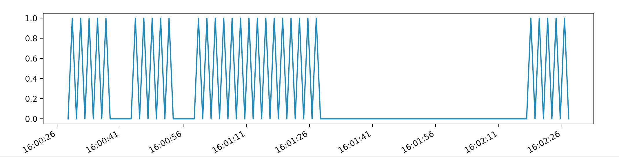
Sensor Data—Computational Challenges
Clean jitters
open
close
open
large gap
Notes:
Here, I show one algorithm to clean jitters. The algorithm automatically learns the next large gap. The interval before this large gap would be an interval with “open” at the beginning and “close” at the end.
Once we imputed the missing values and cleaned the jitters, we can handle the next computational challenge: processing features in real time from streaming data.
For different projects, the features are designed different for real time processing.

Slide 6
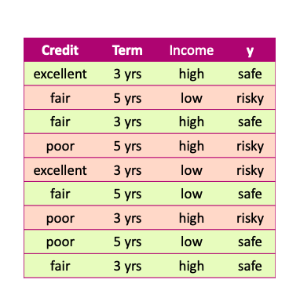
Data
x and y values are known

Slide 7
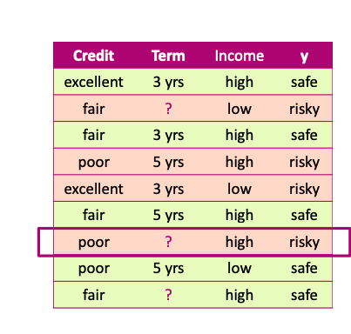
Missing values
Unknown values

Slide 8
Missing values Impact
Missing values impact both training and prediction
Training data: unknown values
Prediction: input for prediction has unknown values

Slide 9
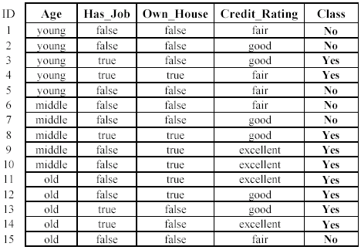
Missing values Impact
Training data: “unknown” values

Slide 10

Missing values Impact
Prediction: input at prediction time with “unknown” values

Slide 11
Handling missing values
Strategy 1: Purification by skipping

Slide 12
Purification by skipping / removing

Slide 13
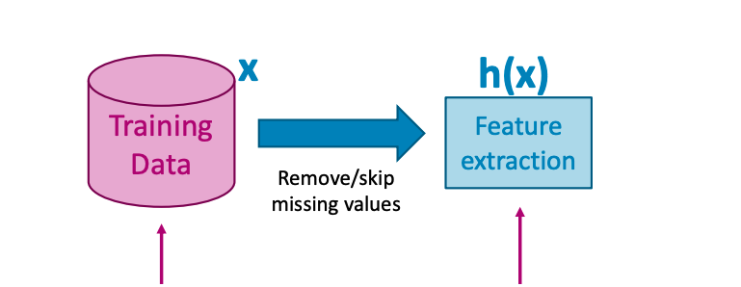
Purification by skipping / removing
Original data with missing values
Data without any missing values

Slide 14
The challenge with skipping / revoming

Slide 15
The challenge with skipping / revoming
Warning: more than 50% of the data are removed!

Slide 16
The challenge with skipping / removing
Idea 2: Skip features with many missing values

Slide 17
The challenge with skipping / removing
Strategy 1: Skip data points with a missing value
- make sure only a few points are skipped
Strategy 2: Skip features with many missing values
- make sure only a few features are skipped

Slide 18
skipping / removing missing values: pros and cons
Pros:
Easy to understand and implement
Applied to all machine learning model
Cons:
Removing data points and features may take off some important information
Unclear when it’s better to remove data points or features
Doesn’t help if data is missing at prediction part

Slide 19
Handling missing values
Strategy 2: Purification by imputing

Slide 20
Main drawback of skipping method
Data is precious.
Do not throw it away.

Slide 21
Can we keep all the data?
Use other data point in the column to “guess” the “missing part”.

Slide 22
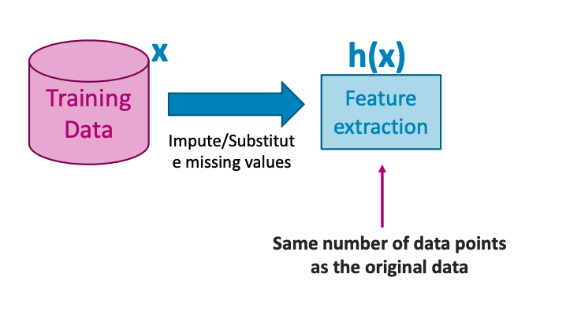
Idea: PURIFICATION BY IMPUTING
Original data with missing values
Same number of data points

Slide 23
Idea: PURIFICATION BY IMPUTING
false
Fill in each missing value with a calculated guess
true
fair

Slide 24
Example: replace with the most common value
false
Fill in each missing value with a calculated guess

Slide 25
Common (simple) rules for imputing
Impute each feature with missing values:
Categorical features: Most popular value of non-missing
Numerical features: Average or median value of non-missing

Slide 26
Missing value imputation: pros and cons
Pros
• Easy to understand and implement
• works for all machine learning models
(logistic regression, decision trees, …)
• works for missing values in the prediction part
use the same imputation rules
Cons
• May have systematic errors
Example: a feature is missing in the entire dataset in one place but is not missing in another dataset.

Slide 27
Missing value Code
Let us do coding together!
Link1: https://beiyulincs.github.io/teach/spring_21/behavior_modeling/project/a_sample.ipynb

Slide 28
STATE OF ART ALGORITHMS FOR SMART ENVIRONMENT
Paper1:
Pavement performance monitoring and anomaly recognition based on crowdsourcing spatiotemporal data
Paper II:
Visual Assistant for Crowdsourced Anomaly Event Recognition in Smart City
Paper III:
Algorithms for cyber security in smart environment

Slide 29
Predicting number of Bike-share Users
Goal: use ML/AI to predict the number of ride-sharing bikes that will be used in any given one hour
Steps:
Data Collection/Curation
Data Management/Representation
Exploratory Data Analysis
Hypothesis Testing and Machine Learning
Communication of insights

Slide 30
Data Collection/Curation
Dataset link
Google co-lab for deep learning models
Data will be dropped into the google drive

Slide 31
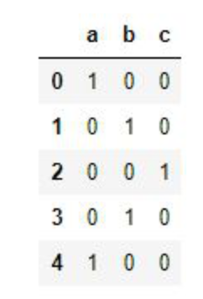
basic Data processing
pandas.get_dummies(): convert categorical data into dummy or indicator variables
Example:
import pandas as pd
con = pd.Series(list('abcba'))
print(pd.get_dummies(con))

Slide 32
Four methods
Linear Regression
Random Forest
Gradient Boost
Deep Learning

Slide 33
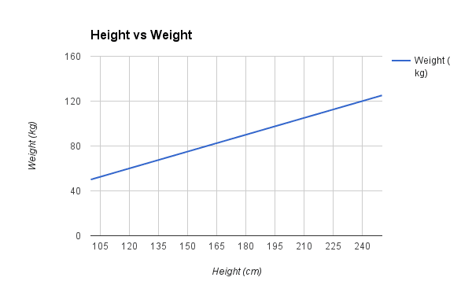
Linear Regression
A simple linear regression:
y = B0 + B1*x
More than one x: a plane / hyper-plane
Assume:
Weight = B0 + B1 * X1
B0: bias coefficient
B1: coefficient for the height column
Assume we learned the B0 = 0.1 and B1 = 0.5

Slide 34
Linear Regression – Data Preparation
Linear Assumption
Remove Noise
Remove Collinearity
Gaussian Distributions ( linear regression will be more reliable if input and output variables have a Gaussian distribution).
Rescale Inputs (standardization or normalization the input data).

Slide 35
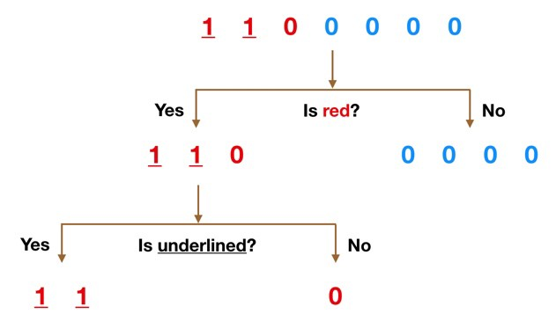
Random forest
Random Forest: consist of a large number of individual decision trees that operate as an ensemble.
for example, the average results of 100 random trees.
What is a random tree?

Slide 36
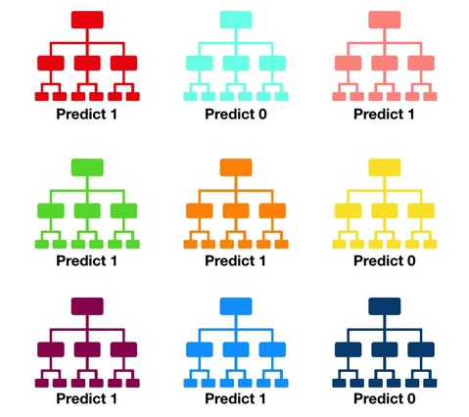
Random forest
Prediction is 1 or 0?

Slide 37
Gradient Boost
Gradient boosting involves three elements:
A loss function to be optimized.
A weak learner to make predictions.
An additive model to add weak learners to minimize the loss function.
loss function:
regression: mean square error;
classification: logarithmic loss;
etc
Provides an accuracy slightly better than random guessing
Weak learners => strong learner

Slide 38
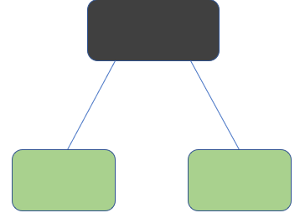
AdaBoost Boost Algorithm
Adaboost: Adaptive Boosting
The most common algorithm used with AdaBoost is Decision Trees with one leave
(one leave <=> one split)
What this algorithm does is that:
Gives equal weights to all the data points
Assigns higher weights to points that are wrongly classified
Now all the points with high weights are given more importance in the next model.
Keep training the model until and unless a lower error is achieved
Notes:
What this algorithm does is that:
Gives equal weights to all the data points
Assigns higher weights to points that are wrongly classified
Now all the points with high weights are given more importance in the next model.
Keep training the model until and unless a lower error is achieved

Slide 39
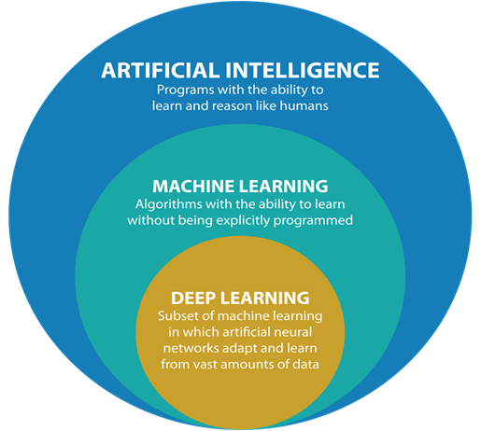
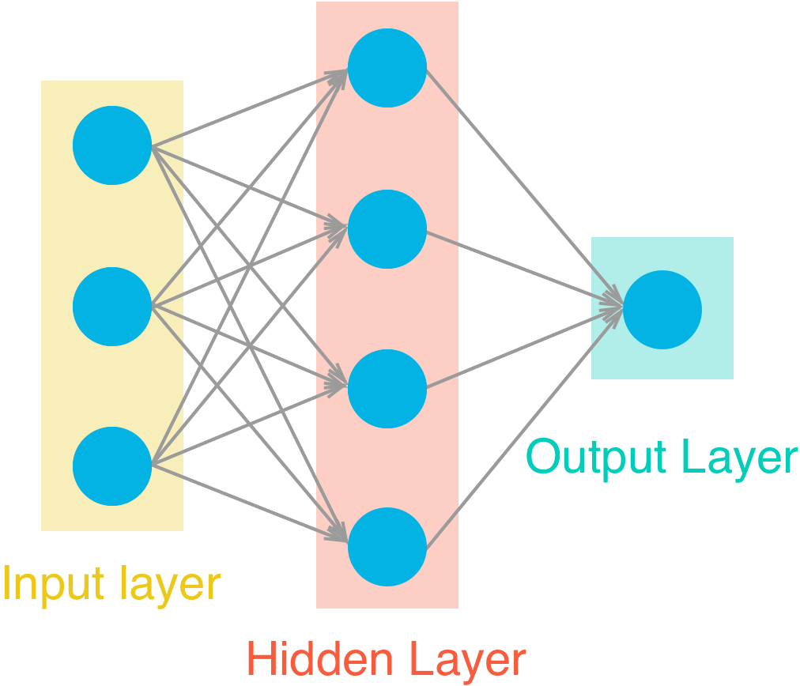
Deep Learning

Slide 40
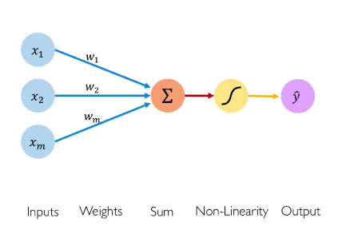
DL: forward propagation of a single neuron
Activation function
Forward propagation:
Pass through multiple input at once as a matrix
(instead of pass input through the network one at a time)
Why do so?
Notes:
Doing this allows for big computational speed ups, especially when using tools like matlab or numpy.

Slide 41



Forward propagation
Input Matrix
Output
Input Matrix:
Dimension:
Number of examples
3X2
3 | 5
5 | 1
10 | 2
70
82
95
3
Output
Dimension:
Number of examples
3X1
3
Hours of
sleep
Hours of
study
Test score

Slide 42
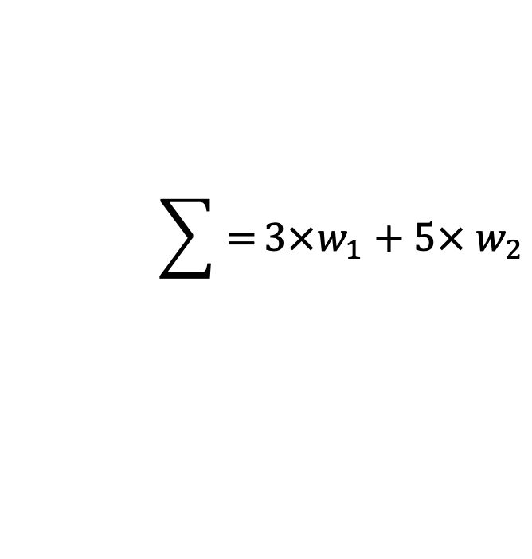
Forward propagation (single neuron)
Input Matrix
3 | 5
5 | 1
10 | 2
$$\sum{=}3×w_{1}+5× w_{2}$$
Hours of
sleep
Hours of
study

Slide 43
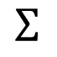
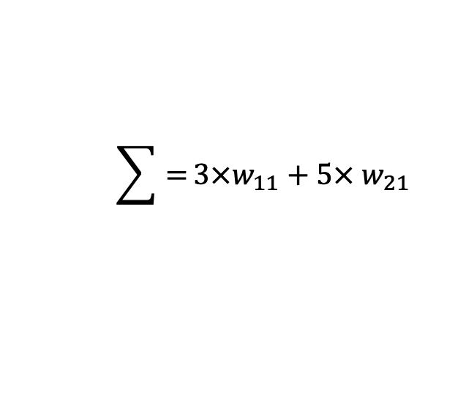
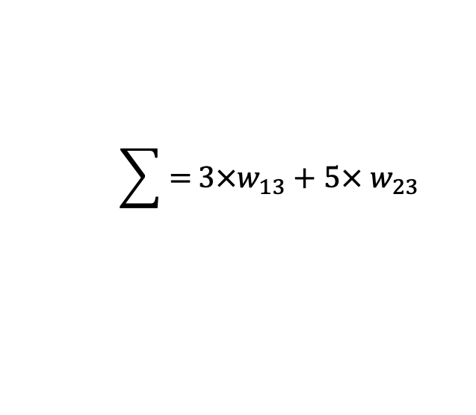
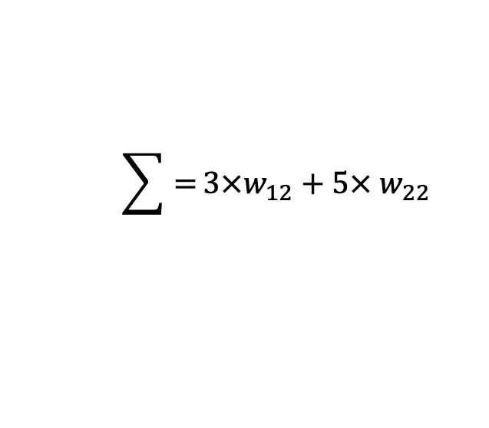
Forward propagation (Multiple neurons)
$$\sum{=}3×w_{11}+5× w_{21}$$
Input Matrix
3 | 5
5 | 1
10 | 2
$$\sum{=}3×w_{12}+5× w_{22}$$
$$\sum{=}3×w_{13}+5× w_{23}$$
Hours of
sleep
Hours of
study
Input
$$∑$$
Output

Slide 44

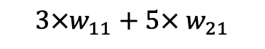

Forward propagation (Multiple neurons)
Input Matrix
3 | 5
5 | 1
10 | 2
$$3×w_{11}+5× w_{21}$$
$$3×w_{12}+5× w_{22}$$
$$3×w_{13}+5× w_{23}$$
w₁₁ | w₁₂ | W₁₃
w₂₁ | w₂₂ | w₂₃
=
Hours of
sleep
Hours of
study

Slide 45
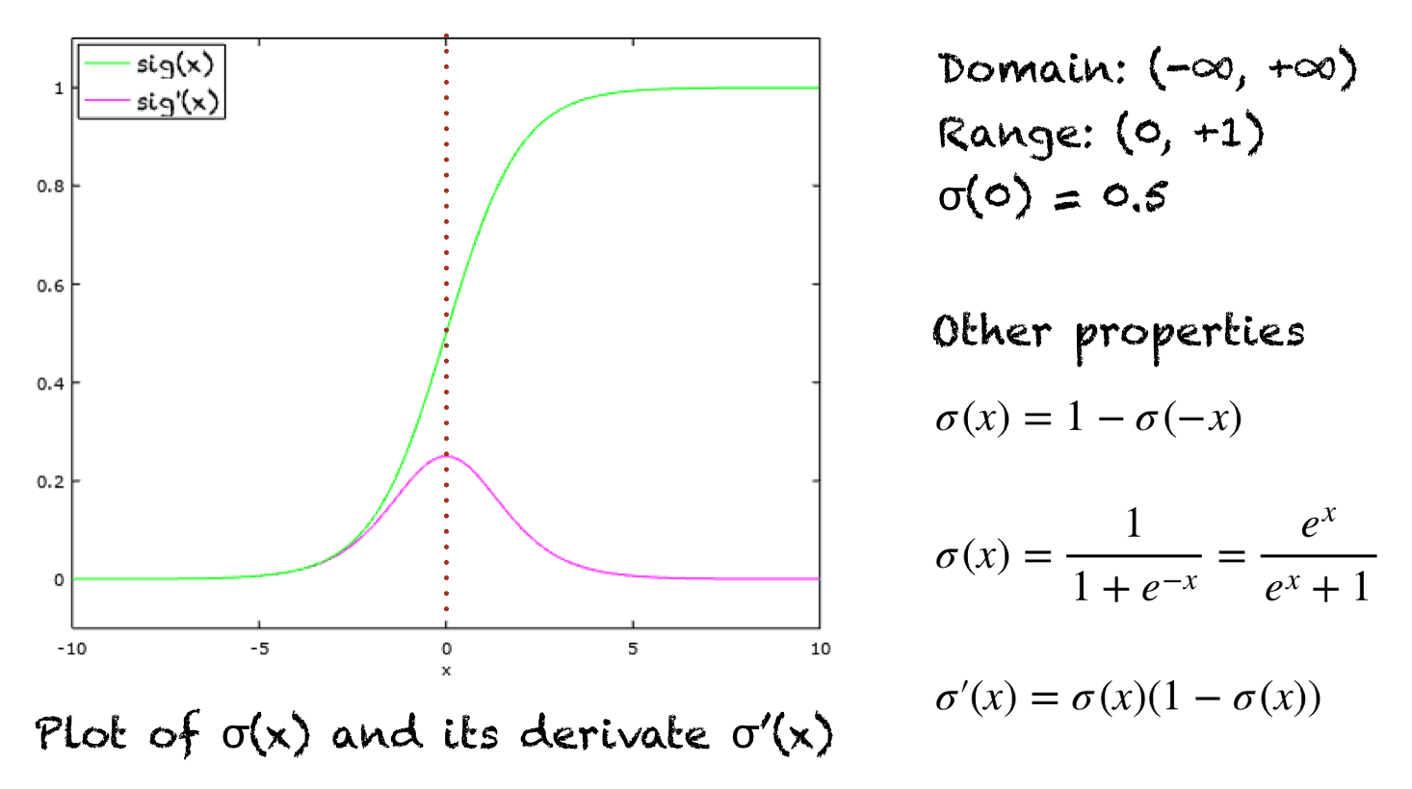
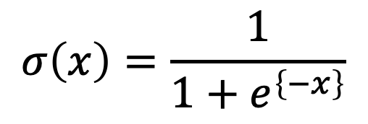
Deep learning – Sigmoid FUNCTION
$$σ\left(x\right)=\frac{1}{1+e^{\left\{−x\right\}}}$$
Properties
Domain: (-∞, +∞)
Range: (0, +1)
σ(0) = 0.5
The function is monotonically increasing.
The function is continuous everywhere.
The function is differentiable everywhere in its domain.
Numerically, it is enough to compute this function’s value over a small range of numbers

Slide 46
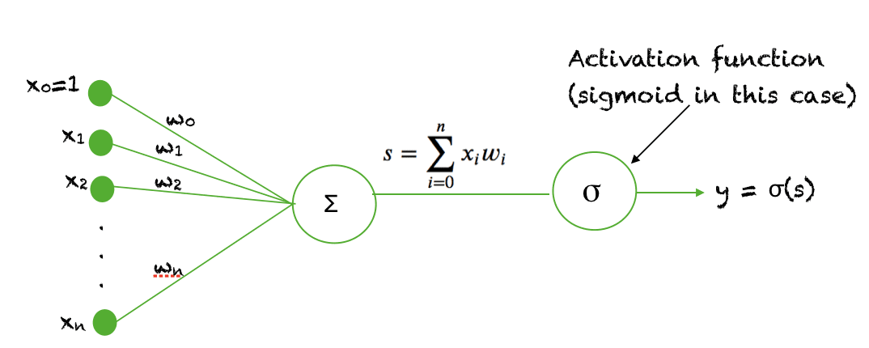
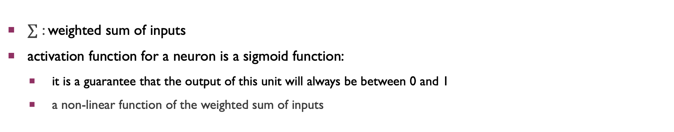
Sigmoid as an activation function in NN
$∑$ : weighted sum of inputs
activation function for a neuron is a sigmoid function:
it is a guarantee that the output of this unit will always be between 0 and 1
a non-linear function of the weighted sum of inputs
Notes:
The sigmoid function is used as an activation function in neural networks. J
activation function, the figure below shows the role of an activation function in one layer of a neural network. A weighted sum of inputs is passed through an activation function and this output serves as an input to the next layer.

Slide 47
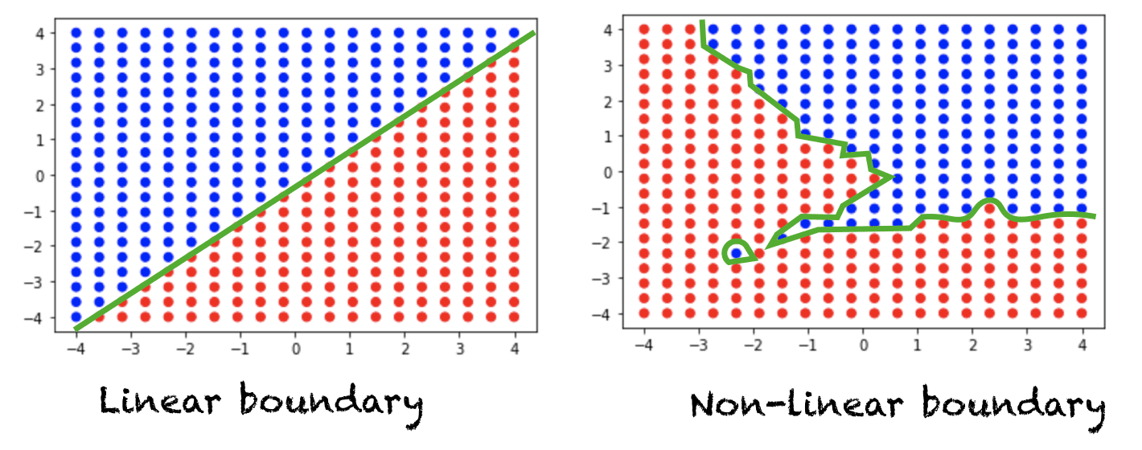
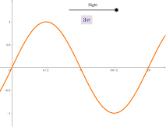
Why sigmoid is important
To learn complex decision functions
Monotonically increasing
How about sin(x)
Should be defined everywhere
Be continuous everywhere
differentiable
Linear activation function in NN
Non-linear activation function in NN

Slide 48
Why Unit Tests
To check the correctness of the network implementation.

Slide 49
Training network
Set the hyperparameters for the network
Find hyperparameters: low error on training + no overfitting
If the training of the network takes long time or have many hidden nodes, would it be good?
Method ( stochastic gradient descent)
For each training pass
Take a random sample of the data ( not using the whole dataset)

Slide 50
Training network
Choose the number of iterations
Choose the learning rate (start with 0.1)
The smaller the learning rate, the smaller the steps are in the weight updates
Longer for the neural network to converge
Choose the number of hidden nodes
More hidden nodes => more accurate the prediction
But more hidden nodes => overfitting

